Slide 1
SUMMARY REPORT ON CHURN
Context:
1. Situation
2. Complication
3. Question
4. Propose solution

Slide 2
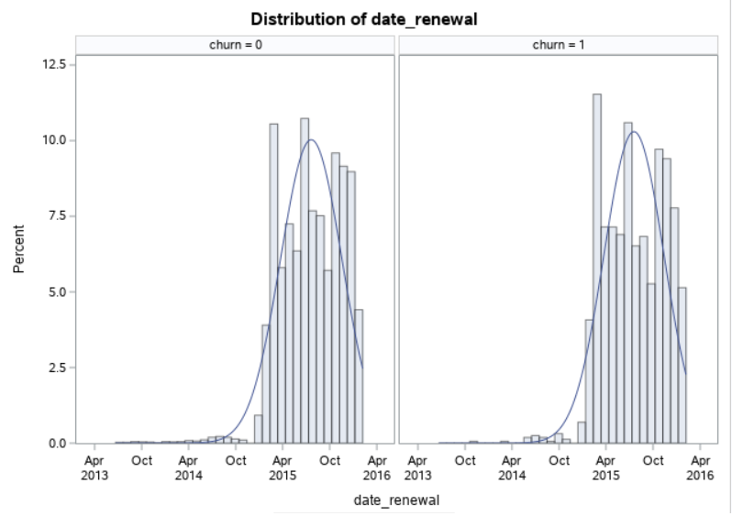
1. Situation * Significant churn problem -Churn rate increases after the 2015.

Slide 3
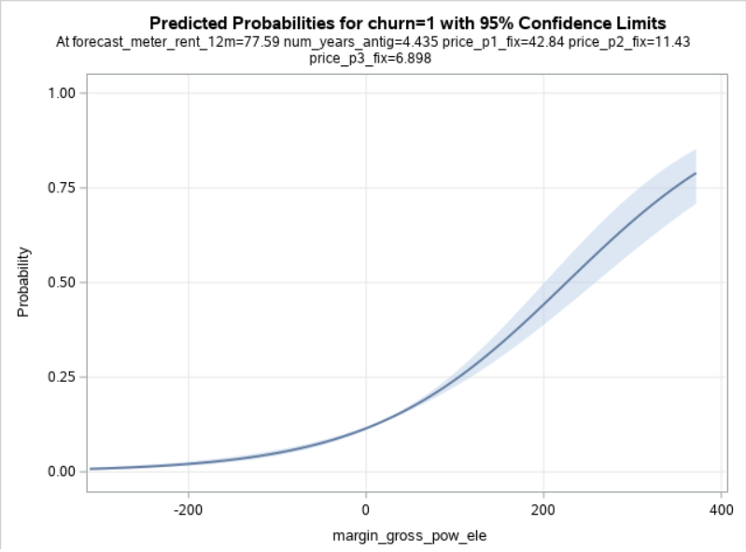
2. Complication *Problem -Considering the plot, we can say that as margin_gross_pow_ele increases, probability of customer leaving the company also increases. -It shows positive relationship.

Slide 4

3. Question *Hypotheses -If company can reduce the gross_margin_pow_ele rate, then churn rate can be reduce

Slide 5
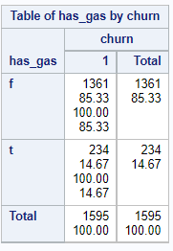
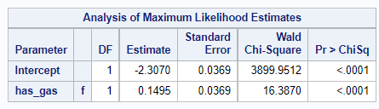
*Solutions -if we look at the table, we notice that, 85.3% customer leave the company who doesn’t have the gas subscription. -Now, we have to focus on customer who doesn’t have the gas subscription and who has high margin_gross_pow_ele. -Considering these two group, we should start a campaign providing new and good offer to these two sections of customer, so that churn rate will decrease.

